Slide 1
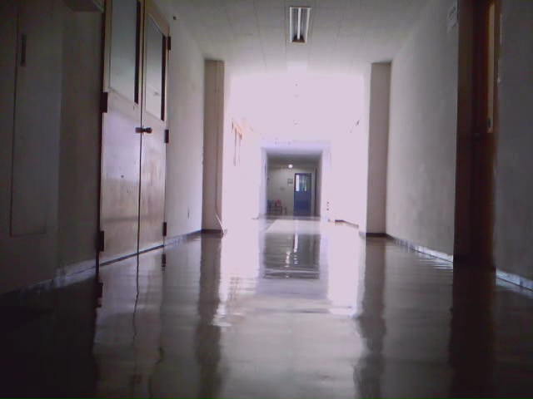
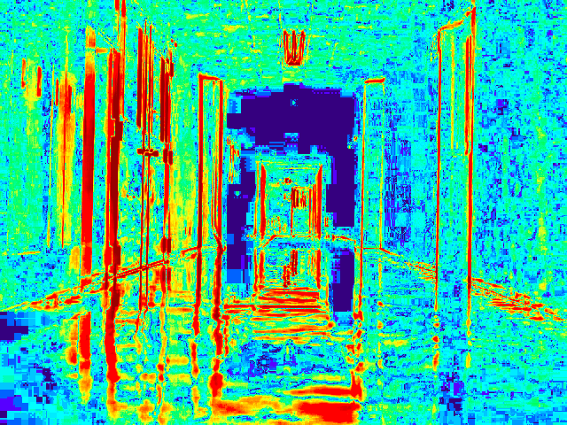
Introduction
Visual Localization for Autonomous Navigation
Teach-replay scheme
Uses monocular camera
  low cost, readily available
Uses difference image
  robust to changes in the environment (e.g. lighting)
Compare difference images from teach step to those from replay step to get robot drift
  but how?

Slide 2
ナビゲーションのための
視覚情報に基づく
自己位置推定
大矢グループ X-MEN
Helio Perroni Filho
Notes:
Good morning everyone, I am Helio Perroni Filho and this is my presentation on Image Stream Synchronization for Visual Navigation.

Slide 3
「教示・再生」を用いた自律走行
教示によりロボットに経路を教える
経路を教えた後で ロボットが自分で経路が通れる
  プログラミングより簡単
  訓練されている オペレータは要らない
出
発
点
オペレータ
ロボット
目
的
地
人が経路上を操作
「教示」ステップ
出
発
点
ロボット
目
的
地
自律走行
「再生」ステップ
Notes:
Currently there is great interest in more intuitive man-machine interfaces for robotics systems, especially robots that can be configured by example, rather than direct programming. The appeal is that robots can then be configured by unskilled operators. This is called teach-replay.
For example, let's say we have an office courier robot to carry documents or supplies from one room to another. If our robot can do teach-replay, first we guide it through the route (what we call the “teach step”),and later, using information gathered along the route, the robot will retrace it autonomously (the “replay step”).

Slide 4
「教示・再生」を用いた自律走行
実現：視覚情報に基づく自律走行
視覚的な手がかり
状況
ランドマークの存在・不在
経路沿いの位置
I6
ランドマークの画像シフト
経路からドリフとの方向
I5
L2
I4
「教示」ステップ
I1
I2
I3
L4
I'1
I'2
I'3
I'4
「再生」ステップ
L1
L3
ランドマーク
Notes:
A lot of work has been done on teach-replay, especially using cameras as sensors. Cameras have many advantages over other kinds of sensors: they are robust, cost-effective, ubiquitous and intuitive to humans.
Work in visual teach-replay navigation has often focused on appearance-based navigation, which uses differences in the appearance of selected landmarks to estimate differences in robot location between teach and replay paths, and effect corrections if necessary.

Slide 5
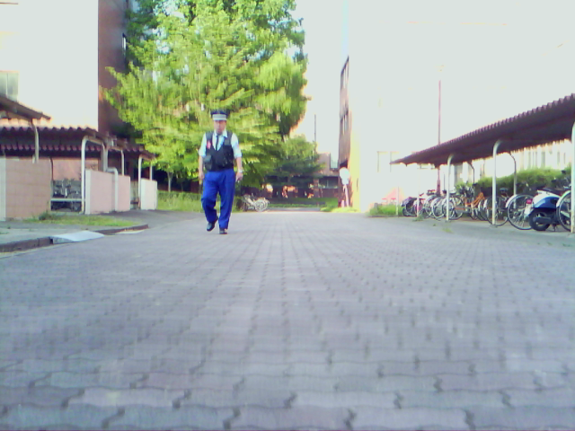
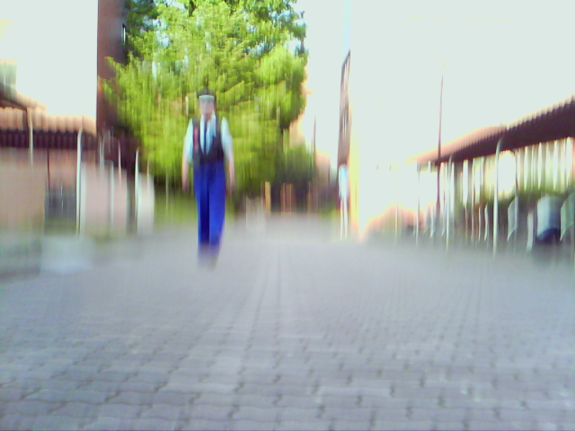
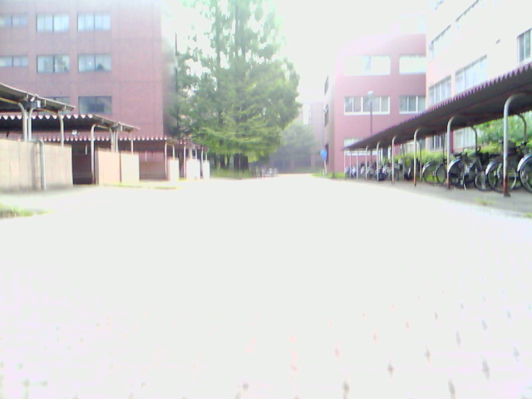
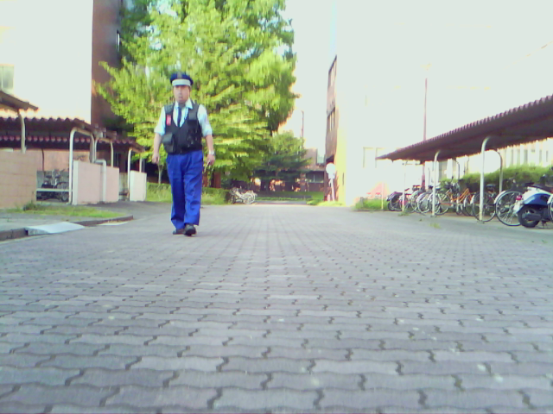
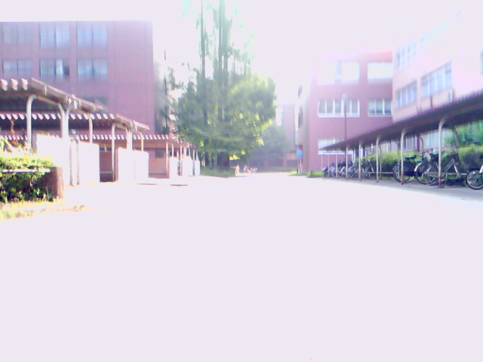
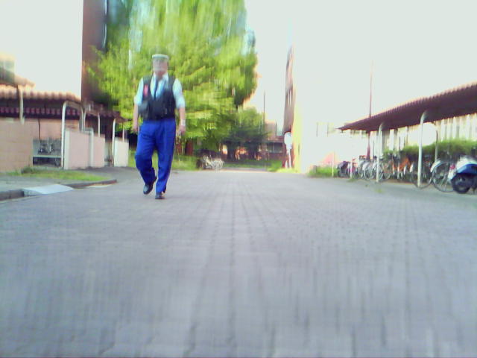
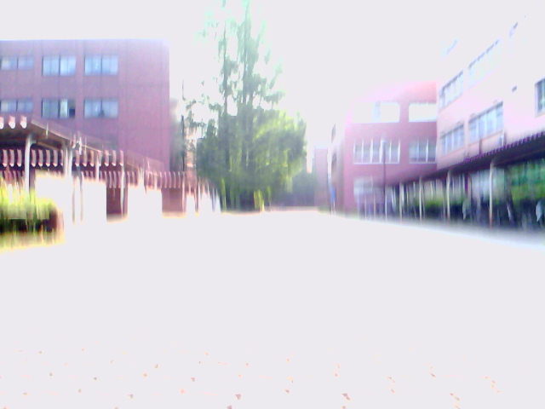
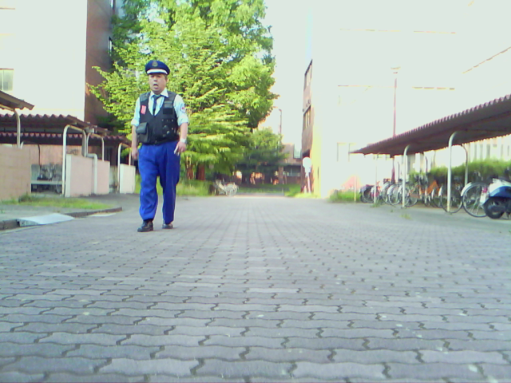
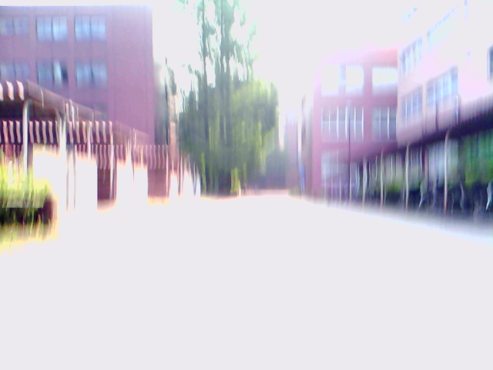
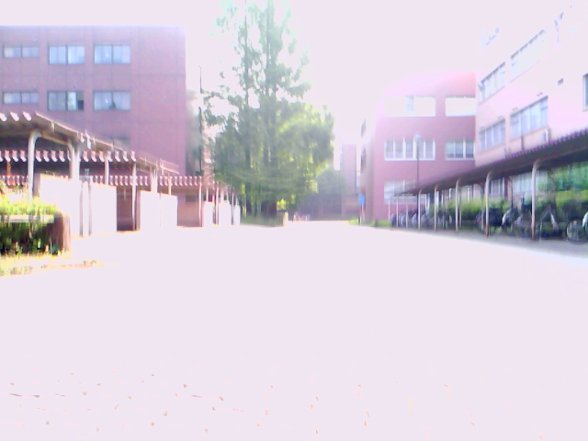
「教示・再生」を用いた自律走行
カメラを使う利点：
  安価
  手に入り易い
  直感的に理解できる
問題：画像不一致
  照明
  隠れ
  移動物体
「再生」ステップ
「教示」ステップ
「画像不変量」を見つけることが必要
Notes:
But extracting physical location from images can be tricky. As can be seen here, lighting changes, occlusion, and the presence of moving elements such as pedestrians can completely change how a landscape looks. It is therefore necessary to find or compute invariants, features that are common to images of a given landscape, despite whatever variations the actual images are subject to.

Slide 6
「教示・再生」を用いた自律走行
視覚情報に基づく自己位置推定の関連研究
方法 | 参照 | カメラ | 環境 | 変化
 |  |  |  | 照明 | 隠れ | 移動 物体
テンプレート照合 | [8] | 単眼カメラ | 屋内 | × | × | ×
コスト関数の最適化 | [9] | 単眼カメラ | 屋内 | × | × | ×
相互情報量 | [10] | 単眼カメラ | 屋内 | × | ○ | ○
特徴点の追跡 | [11] | 単眼カメラ | 屋内・屋外 | ○ | × | ○
局所最大の相性 | [12] | 単眼カメラ | 屋外 | ○ | ○ | ○
ステレオ特徴点の マッチング | [13] | ステレオカメラ | 屋内 | ○ | ○ | ○
平均ランドマーク ベクトル | [14] | パノラマ式カメラ | 屋内 | ○ | × | ×
オプティカル・フロー | [15] | パノラマ式カメラ | 屋内 | ○ | ○ | ×
本研究 |  | 単眼カメラ | 屋内・屋外 | ○ | ○ | ○
Notes:
Here I show some of the image pairing methods that have been proposed over the years – you can find the respective articles on my report's bibliography, these are their reference numbers. Unfortunately most of them fall short one way or another. A common limitation is for a method to only work indoors or outdoors. Difficulties on dealing with moving elements, such as people, or occlusions are also common. Some methods also require non-standard hardware, such as stereo or panoramic cameras.
Therefore, there is still demand for an image pairing method that works well indoors and outdoors, uses simple hardware such as a single monocular camera, and can deal with changes in lighting and the presence of occlusion and moving objects.

Slide 7
「教示・再生」を用いた自律走行
本研究：「Differential Visual Streams・DiVS」
画像シーケンスから安定な推定
キャリブレーションの必要が少ない
  例えば：焦点距離
照明変化・隠れ・移動物体にロバスト
屋内外で使用可能
Notes:
The limitations of current image pairing methods have motivated me to look for a new solution, which I call feature point correlation.
It works on image sequences, generating stable representations that are robust to changes in lighting, occlusions and the presence of moving elements. It is applicable to indoors and outdoors environments, requiring a single, uncalibrated monocular camera as input.

Slide 8
目次
「教示・再生」を用いた自律走行
方法（DiVS）
  差分画像シーケンスの計算
  教示・再生差分画像シーケンスを同期
  教示・再生差分画像シフトを推定
実験・結果
まとめ
Notes:
The feature point correlation method and its application to teach-replay are the subjects of the remainder of this presentation.
In the next section I describe the method. Then I show experimental results that demonstrate the method's performance both indoors and outdoors. Finally I discuss directions for further research.

Slide 9
差分画像シーケンスの計算
画像シーケンス
（例：録画から）
サンプリングされた
画像シーケンス
差分画像シーケンス
…

Slide 10
目次
「教示・再生」を用いた自律走行
方法（DiVS）
  差分画像シーケンスの計算
  教示・再生差分画像シーケンスを同期
  教示・再生差分画像シフトを推定
実験・結果
まとめ
Notes:
The feature point correlation method and its application to teach-replay are the subjects of the remainder of this presentation.
In the next section I describe the method. Then I show experimental results that demonstrate the method's performance both indoors and outdoors. Finally I discuss directions for further research.

Slide 11
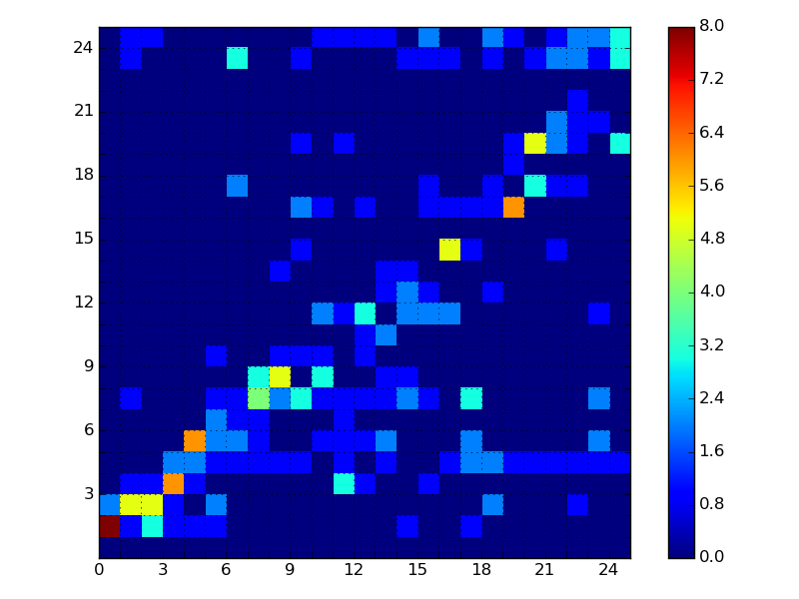
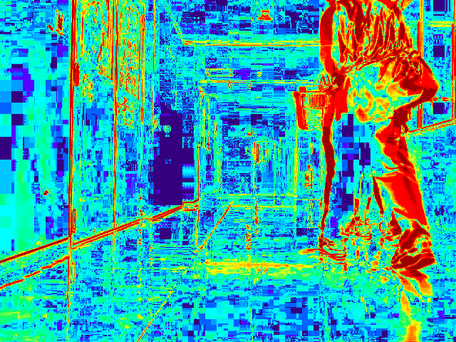
差分画像シーケンスを同期
「教示」差分画像シーケンス
対応マップ
α
「教示」差分画像のインデックス
f(Di, D'j)
特徴点
「再生」差分画像シーケンス
「再生」差分画像のインデックス
f(Di, D'j) = gij
Di ∈ Qt
D'j ∈ Qr
gij ∈ ℕ：DiとD'jとの対応強度
β
特徴点
Notes:
Let's start with two image sequences, a teach sequence recorded from the teach step, and a replay sequence recorded during the current replay step.
Now assume we have a function f() that returns a vector of positive integers representing the similarities between each replay image j and all teach images i. I will discuss how to define this function later. For now let's just assume that this function is “good” but not “perfect”: that is, in general it does return higher values for more closely related image pairs and lower values otherwise, but sometimes it may produce dubious or plain incorrect results.
If we compute these vectors for each replay image, arrange them in columns and plot a contour map of the resulting matrix, we'll likely get a result like this. In this map hotter colors indicate higher similarity and colder colors, lower.

Slide 12
目次
「教示・再生」を用いた自律走行
方法（DiVS）
  差分画像シーケンスの計算
  教示・再生差分画像シーケンスを同期
  教示・再生差分画像シフトを推定
実験・結果
まとめ
Notes:
The feature point correlation method and its application to teach-replay are the subjects of the remainder of this presentation.
In the next section I describe the method. Then I show experimental results that demonstrate the method's performance both indoors and outdoors. Finally I discuss directions for further research.

Slide 13
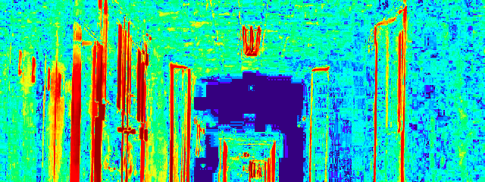
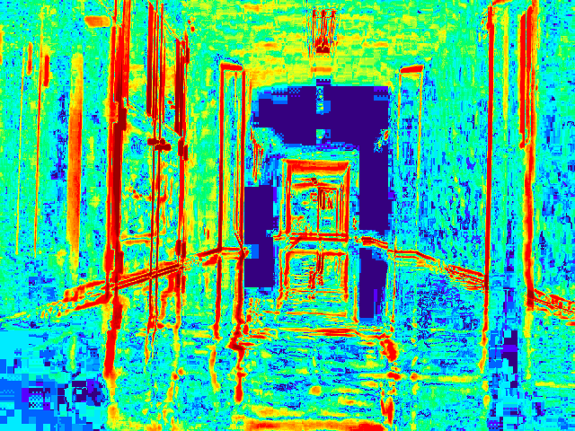
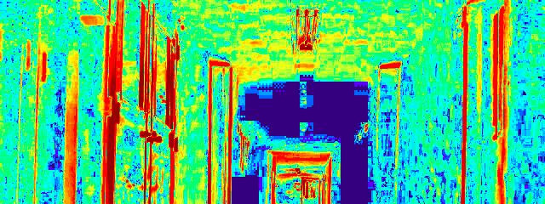
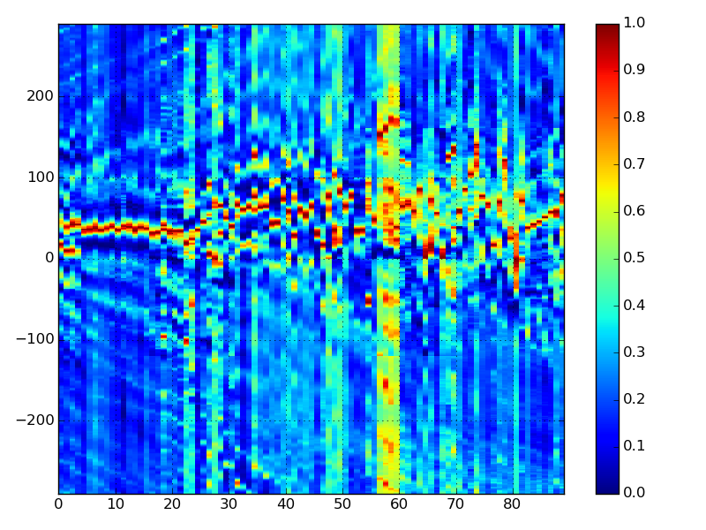
教示・再生差分画像シフトを推定
教示・再生差分画像の1D相互相関
相互相関ベクトル
⭑
「教示」差分画像
「再生」差分画像
Ck
Di
D'j
シフトマップ
Ck
「シフトマップ」の作成
左右シフト
「再生」差分画像のインデックス

Slide 14
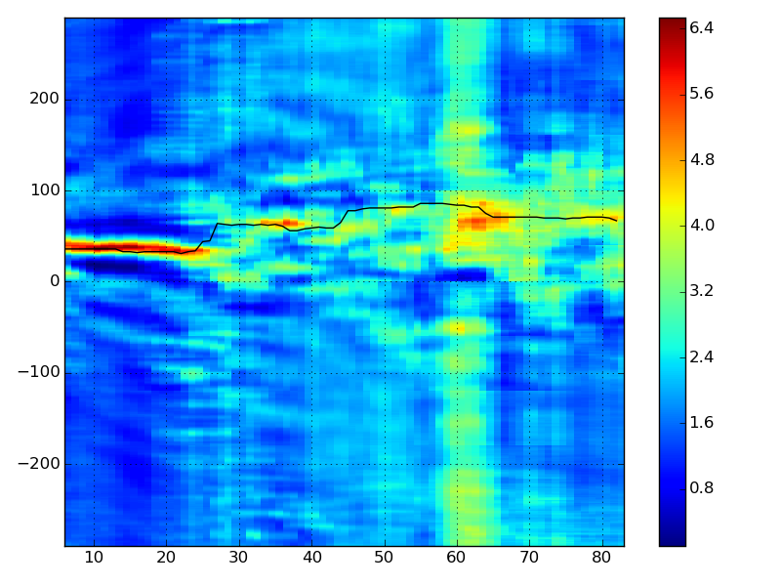
教示・再生差分画像シフトを推定
平均シフトマップの作成・シフトの推定
シフトマップ
平均シフトマップ
左右シフト
左右シフト
「再生」差分画像のインデックス
「再生」差分画像のインデックス

Slide 15
方法（要点）
「教示」差分画像シーケンス
（「教示」ステップに録画した）
Di
「再生」差分画像シーケンス
(リアルタイム)
D'j
同期
シフト
推定
D5
L2
D4
「教示」ステップ
D1
D2
D3
L4
D'1
D'2
D'3
D'4
「再生」ステップ
L1
L3
ランドマーク

Slide 16
目次
「教示・再生」を用いた自律走行
方法（DiVS）
  差分画像シーケンスの計算
  教示・再生差分画像シーケンスを同期
  教示・再生差分画像シフトを推定
実験・結果
まとめ
Notes:
The feature point correlation method and its application to teach-replay are the subjects of the remainder of this presentation.
In the next section I describe the method. Then I show experimental results that demonstrate the method's performance both indoors and outdoors. Finally I discuss directions for further research.

Slide 17
実験・結果
実験条件
  並進速度 v = 0.3m/s
  画像サイズ640x320、入力周波数20FPS（毎秒20画像）
  パラメーター(τ, α, β, ω) = (25, 30, 110, 6)
実験環境・経路
「屋内」直進
「屋内」左折
「屋内」右折
「再生」ステップ
「教示」ステップ
「教示」ステップ
「再生」ステップ
「屋外」直進
「教示」ステップ
「再生」ステップ
「再生」ステップ
「教示」ステップ
Notes:
All field test procedures were performed under the same system parameters as shown here.
Two test environments were selected, one outdoors, one indoors. The outdoors environment is the paved way through building D of the University of Tsukuba; the indoors environment is the corridor in front of room D402. For each environment two runs were recorded for offline processing. In the outdoors environment the second run differed from the first by a yaw 2 degrees to the right, and in the indoors environment, two degrees to the left. The outdoors test had to be limited to a 15m straight run to avoid reaching a patch of especially rough terrain; the indoors test was allowed to run for 20m.

Slide 18
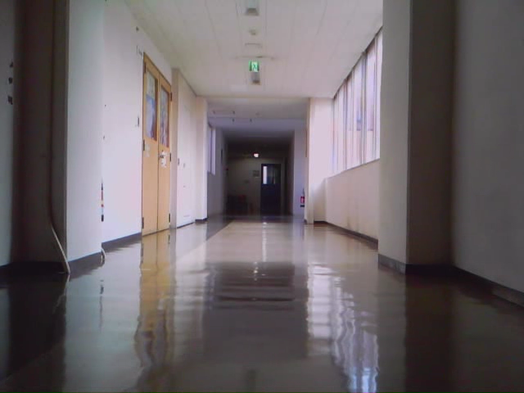

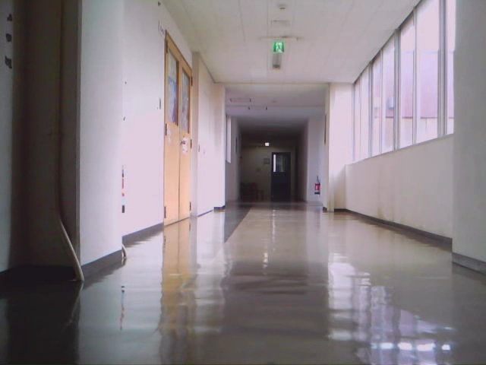
実験・結果
推定
「屋内直進」実験
正解データ
教示
左右シフト
「再生」差分画像のインデックス
再生
ほぼ良い結果
正解データとの差は少ない
Notes:
Results were more dubious for the indoors environment. The similarity map was denser, but the line sequence correlation computed over it was somewhat divergent from a manual evaluation. However this was still a good enough result for the purposes of pairing up images for use with DiVS.

Slide 19
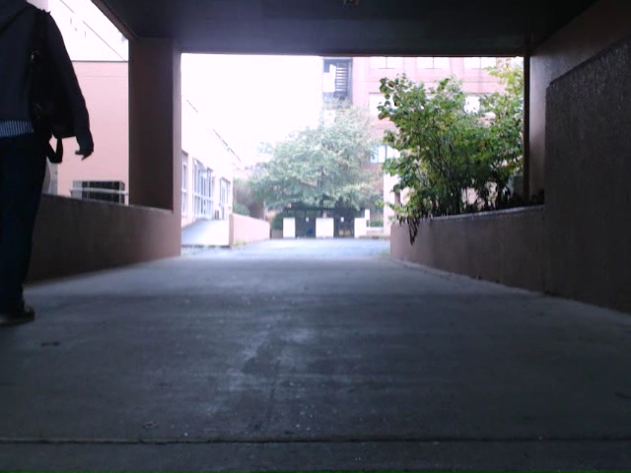
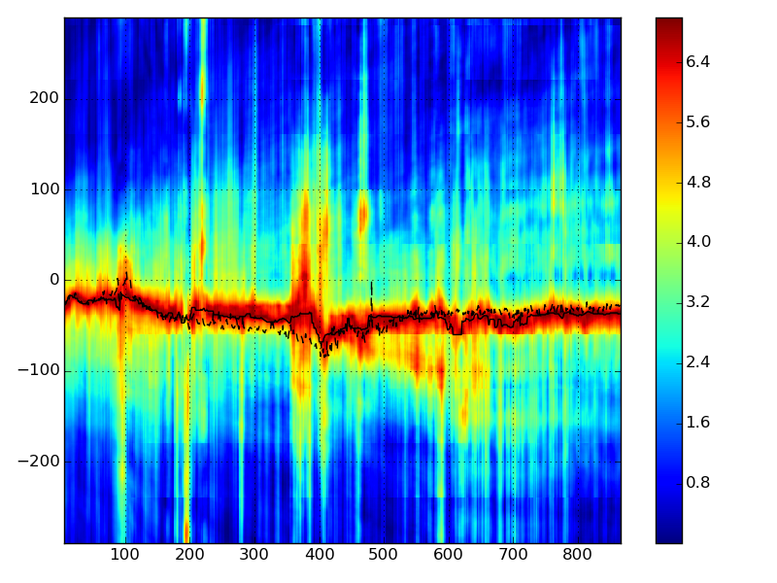
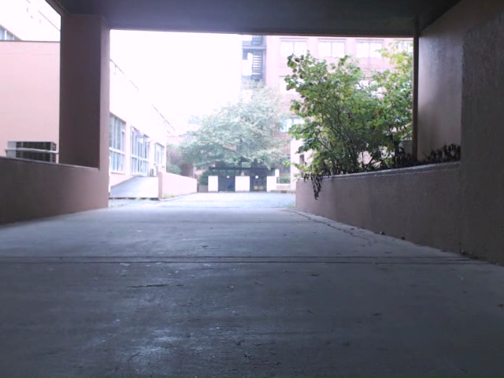
実験・結果
推定
「屋外直進」実験
正解データ
教示
左右シフト
「再生」差分画像のインデックス
再生
良い結果
推定したシフトは完全に正解データと合う
Notes:
Results for the outdoors test were remarkably good, considering the relative lack of distinct features in this environment. The similarity map was rather sparse, with interspersed islands of good matches, but even so the estimated image pairing, represented here by this dashed line crossing the similarity map, agreed very well with pairing performed by a human (in this case, me).

Slide 20
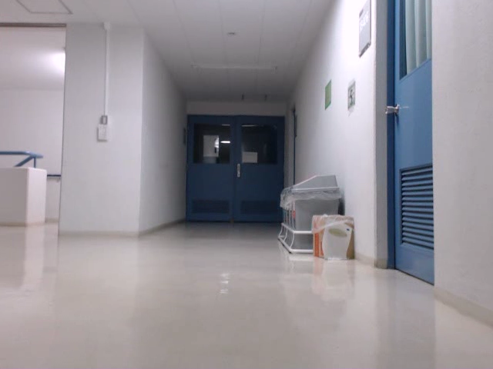
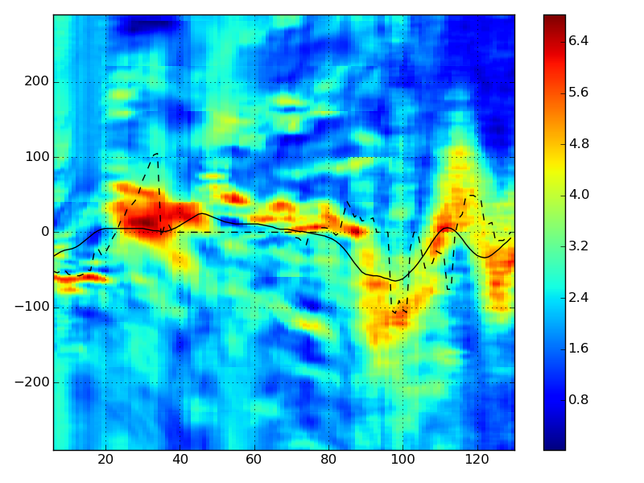
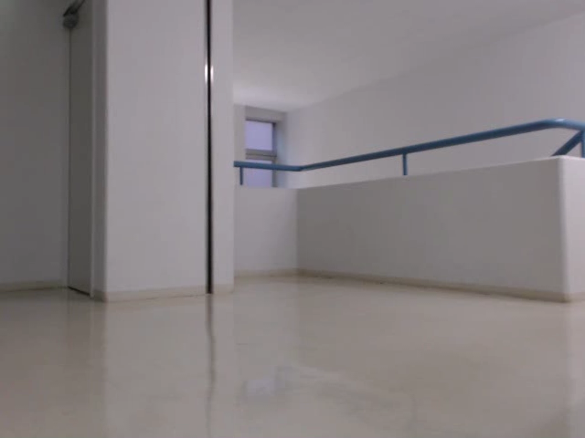
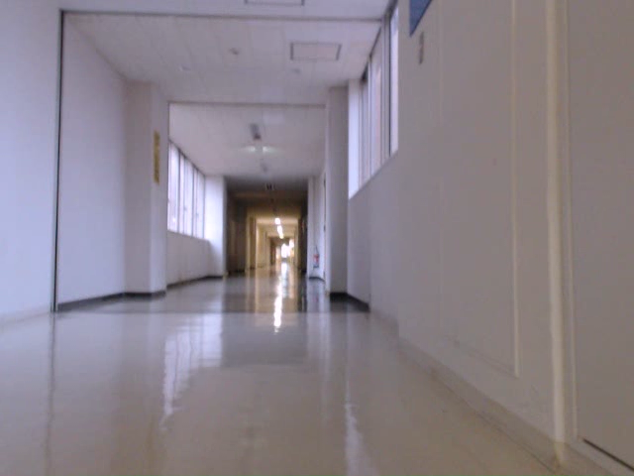
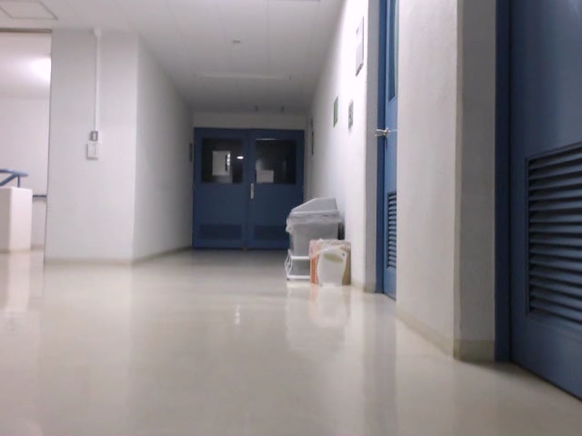
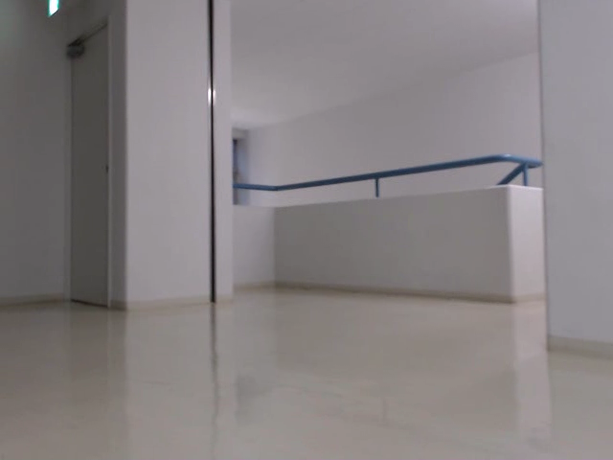
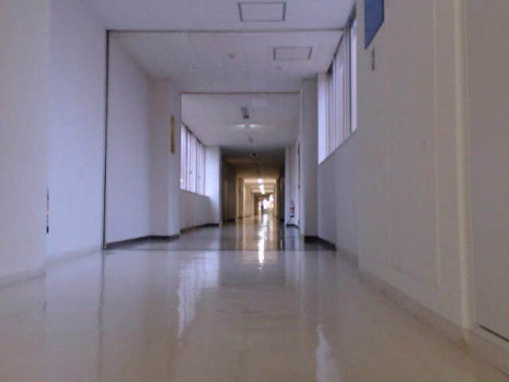
実験・結果
推定
「屋外左折」実験
正解データ
教示
左右シフト
再生
「再生」差分画像のインデックス
ほぼ良い結果
シフトマップは正解データとほとんど合う
Notes:
Results for the outdoors test were remarkably good, considering the relative lack of distinct features in this environment. The similarity map was rather sparse, with interspersed islands of good matches, but even so the estimated image pairing, represented here by this dashed line crossing the similarity map, agreed very well with pairing performed by a human (in this case, me).

Slide 21
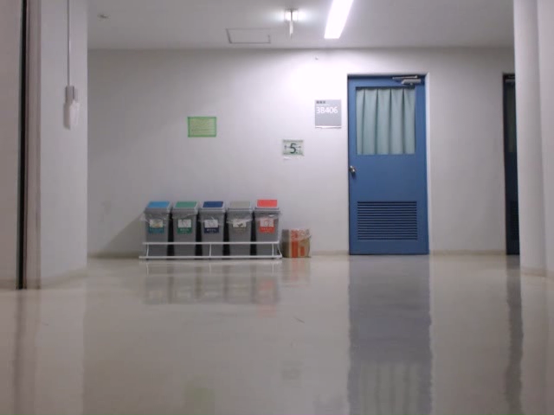
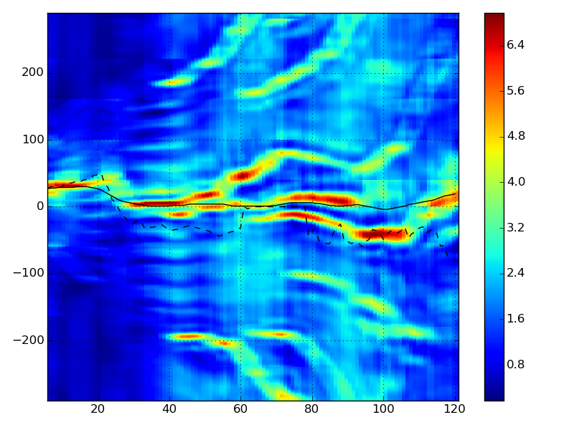
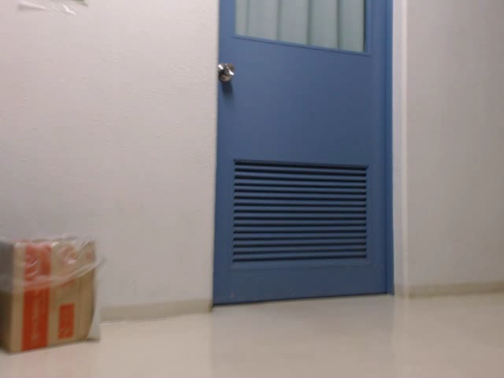
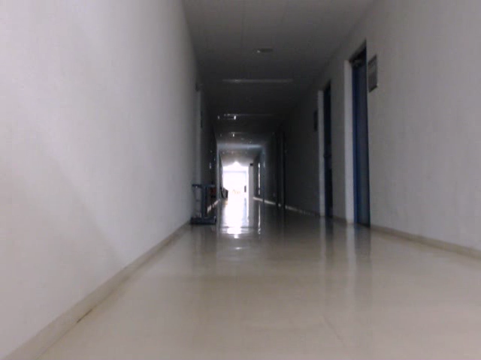
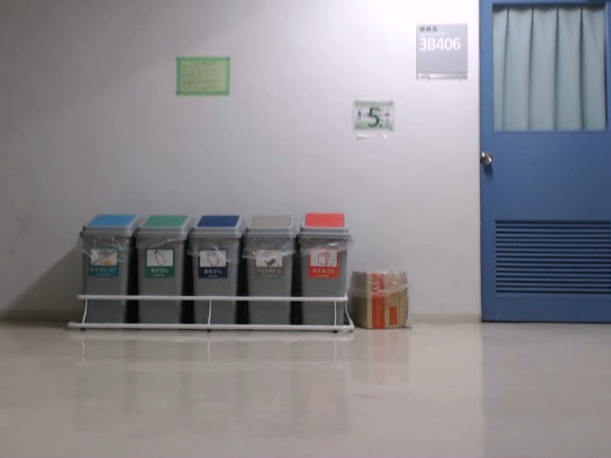
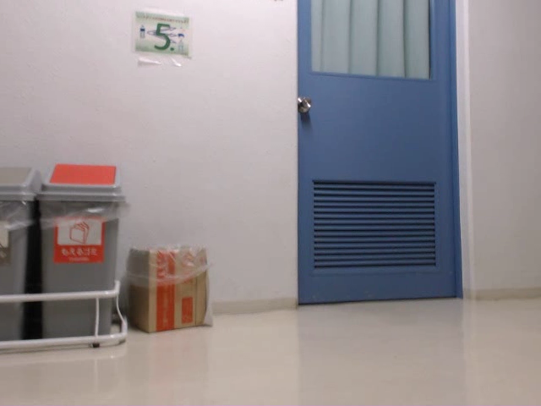
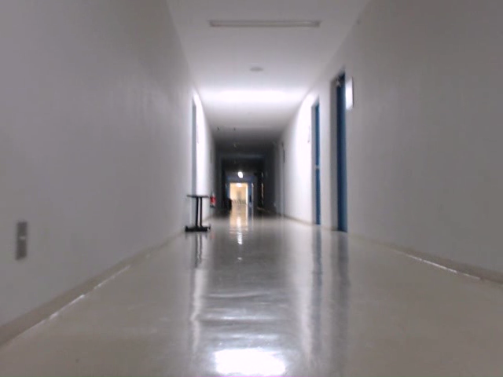
実験・結果
推定
「屋外右折」実験
正解データ
教示
左右シフト
再生
「再生」差分画像のインデックス
ほぼ良い結果
シフトマップは参照データとほとんど合う
Notes:
Results for the outdoors test were remarkably good, considering the relative lack of distinct features in this environment. The similarity map was rather sparse, with interspersed islands of good matches, but even so the estimated image pairing, represented here by this dashed line crossing the similarity map, agreed very well with pairing performed by a human (in this case, me).

Slide 22
目次
「教示・再生」を用いた自律走行
方法（DiVS）
  差分画像シーケンスの計算
  教示・再生差分画像シーケンスを同期
  教示・再生差分画像シフトを推定
実験・結果
まとめ
Notes:
The feature point correlation method and its application to teach-replay are the subjects of the remainder of this presentation.
In the next section I describe the method. Then I show experimental results that demonstrate the method's performance both indoors and outdoors. Finally I discuss directions for further research.

Slide 23
まとめ
「DiVS」は差分画像シーケンスを使用
差分画像シーケンスを同期し、左右シフトを推定
画像の変化や環境の変化にロバスト
今後の予定
  異なる環境で実験
  処理時間の高速化
  差分画像シフト推定方法を向上
Notes:
Feature point correlation is a method for pairing up images from different sequences. During tests it produced consistent results against changes in lighting, occlusion and the presence of moving elements.
From this point on my intention is to further evaluate the method, especially over longer routes and varying speeds, improve runtime performance so it can be used in real-time, and also experiment with other methods to extract the image correlation from the similarity map, for example using RANSAC.

Slide 24
終わり
以上
Notes:
This is the end of my presentation. Any questions?

